Slide 1
MET 2010 WEATHER & CLIMATE
Summer 2012
“CLIMATE IS WHAT WE EXPECT – WEATHER IS WHAT WE GET”

Slide 2
Contacts
Instructor
Aaron Evans
Teaching Assistant:
Manuel McIlroy
See syllabus for office hours, locations & contact information

Slide 3
Blackboard (Bb)
Go to http://blackboard.fau.edu
Not available if you are not registered for class!
Announcements
Syllabus
Online Notes / Reviews
Quizzes
Assignments
Extra Credit

Slide 4
My Meteorology Lab
Additional Material/Assignments
Instructions on Blackboard/Assignments
Get Code From Textbook
Can Also Purchase Code Separately
Points Earned in My Meteorology Added As Extra Credit

Slide 5
ONLINE NOTES
These are available at LECTURES
They are versions of THIS slide-show with _____ replacing some keywords
They do not take the place of coming to lecture, but will make taking notes easier
Write down highlighted keywords and you can fill in the _______ later.

Slide 6
EVALUATION
Quizzes: 60%
Assignments: 40%
Extra credit: 10%
Total 110%
Each quiz has approximately 10-15 multi-choice questions, are NOT cumulative!

Slide 7
COURSE OUTLINE
Part I: Energy in the atmosphere
Part II: Atmosphere/Hydrosphere interactions
Part III: Wind
Part IV: Violent weather
Part V: Climatic change

Slide 8
Before We Start!
Taking this class will NOT turn you into:
Megan Glaros, Channel 10 News
Jim Cantore, The Weather Channel
Elita Loresca, Channel 7 News

Slide 9
TODAY’S CLASS OUTLINE
Introduction
Weather vs. Climate
Earth Atmosphere System
Introductory Geography: Latitude & Longitude
History of Meteorology

Slide 10
INTRODUCTION: WEATHER VS. CLIMATE

Slide 11
Weather vs. Climate
WEATHER
Condition of atmosphere at a particular time & place, measuring the 7 elements of weather.
Always changing.

Slide 13
7 Elements of Weather…
Air Temperature
Air Pressure
Humidity
Wind
Visibility
Precipitation
Clouds

Slide 14
Weather vs. Climate
CLIMATE:
Weather elements measured & statistically analyzed over a specific time interval (usually 30 years) for a particular region… extremes are included.
i.e. ‘Average Weather’

Slide 16
Earth Atmosphere System
What IS a system? Some examples…
“A regularly interacting or interdependent group of items forming a unified whole” <a number system>
“a group of body organs that together perform one or more vital functions” <the digestive system>
“a group of devices or artificial objects or an organization forming a network especially for distributing something or serving a common purpose” <a telephone system> <a heating system> <a computer system>
Merriam-Webster

Slide 17
Earth Atmosphere System
EAS defines an intricate system where no process is truly isolated
Each component of the EAS is essential to life on earth as we know it…
Although the 4 components can be studied separately, they function together

Slide 18
4 Components of EAS
Geosphere
The solid earth – includes soils, rocks, mountains, etc.
Atmosphere
Gases and particulate matter, including the air that we breathe.

Slide 19
4 Components of EAS
Hydrosphere
Water within, on top of and above the earth’s surface.
Biosphere
The environment of ‘life’ on earth (animals, plants, humans, etc…).

Slide 20
Latitude and Longitude
Lat. & Long. provide a grid-like positioning system on earth.
Allows us to find location & to discuss key meteorological concepts such as:
solar declination (sun angle changes with season) and
latitudinal energy receipt.

Slide 21
Latitude
Degrees north and south of equator as series of parallel lines
The single most important attribute controlling temperature

Slide 22
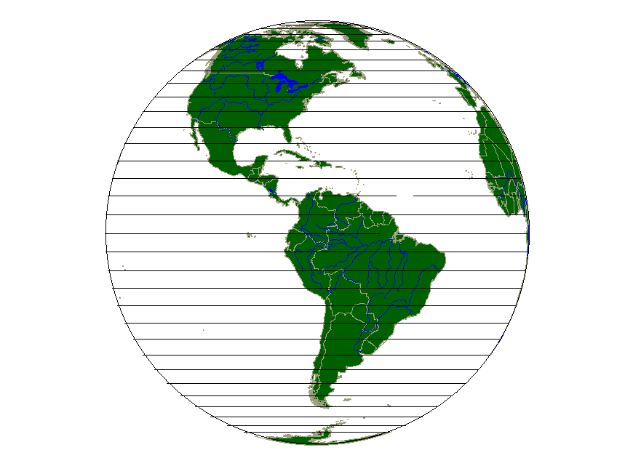

Slide 23
Longitude
Degrees east and west of Greenwich, London, UK
lines converging on the poles (like segments of an orange).
Lines are also known as MERIDIANS

Slide 25
Graticule:
(latitude / longitude)
Notes:
Most important ones to remember:
Longitude:
PRIME MERIDIAN 0, INTERNATIONAL DATELINE 180 EAST or WEST and
Florida Coastline, Palm Beach County is 80° WEST
98° W is Dry Line on Great Plains
Latitude:
Equator = 0, Poles = 90
25 Degrees Runs between Key Largo and Paradise Key, South of this is the
tropics
Jacksonville, New Orleans, Houston, San Antonio, and Cairo, Egypt are
about 30 DEGREES

Slide 26
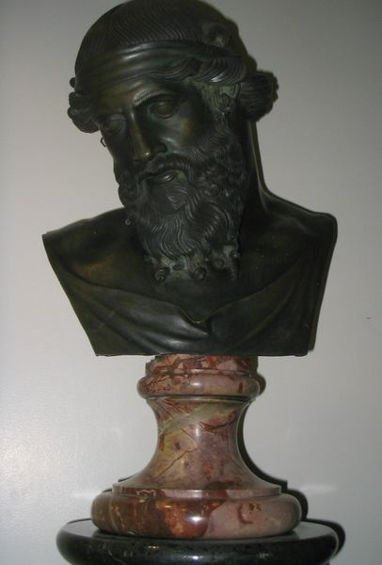
History of Meteorology
350 BC
Aristotle wrote ‘METEOROLOGICA’
Natural philosophy including weather, climate, astronomy, geography, & chemistry.

Slide 27
History of Meteorology
350 BC
He explained what he saw, or thought he saw
NO detailed observation, NO experiments.
Book was erroneous, but accepted.
No real science until the Renaissance.

Slide 28
History of Meteorology
Late 16th Century
Thermometer - Temperature
1643
Barometer - Pressure
Late 18th Century
Hygrometer - Water vapor content of air

Slide 29
History of Meteorology
Able to MEASURE weather elements, so SCIENTIFIC explanations began. Physical laws being developed at this time.
1843: Telegraph
Transmission of weather observations allowed simple forecasting & weather maps.
Winds and storms partially understood.

Slide 30
History of Meteorology
1920:
Air masses & weather fronts explained by Norwegian scientists.
1940s:
Daily upper atmosphere observations began via air balloons (radiosonde measurements).

Slide 31
History of Meteorology
1950s:
Computers!
Able to solve some equations that describe the behavior of the atmosphere, enabling the creation of current weather maps.
They were then developed to predict or forecast the state of the atmosphere in the (short-term) future.

Slide 32
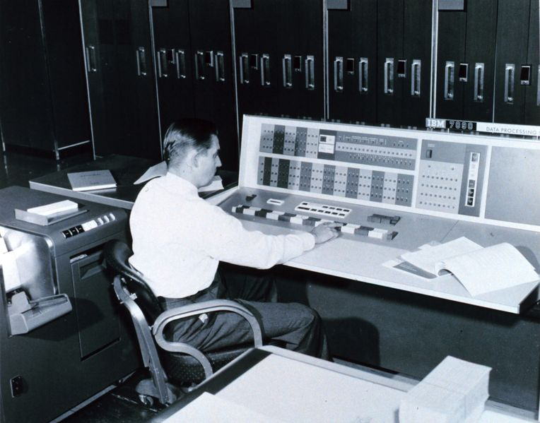
A meteorologist at a 1965 computer!

Slide 33
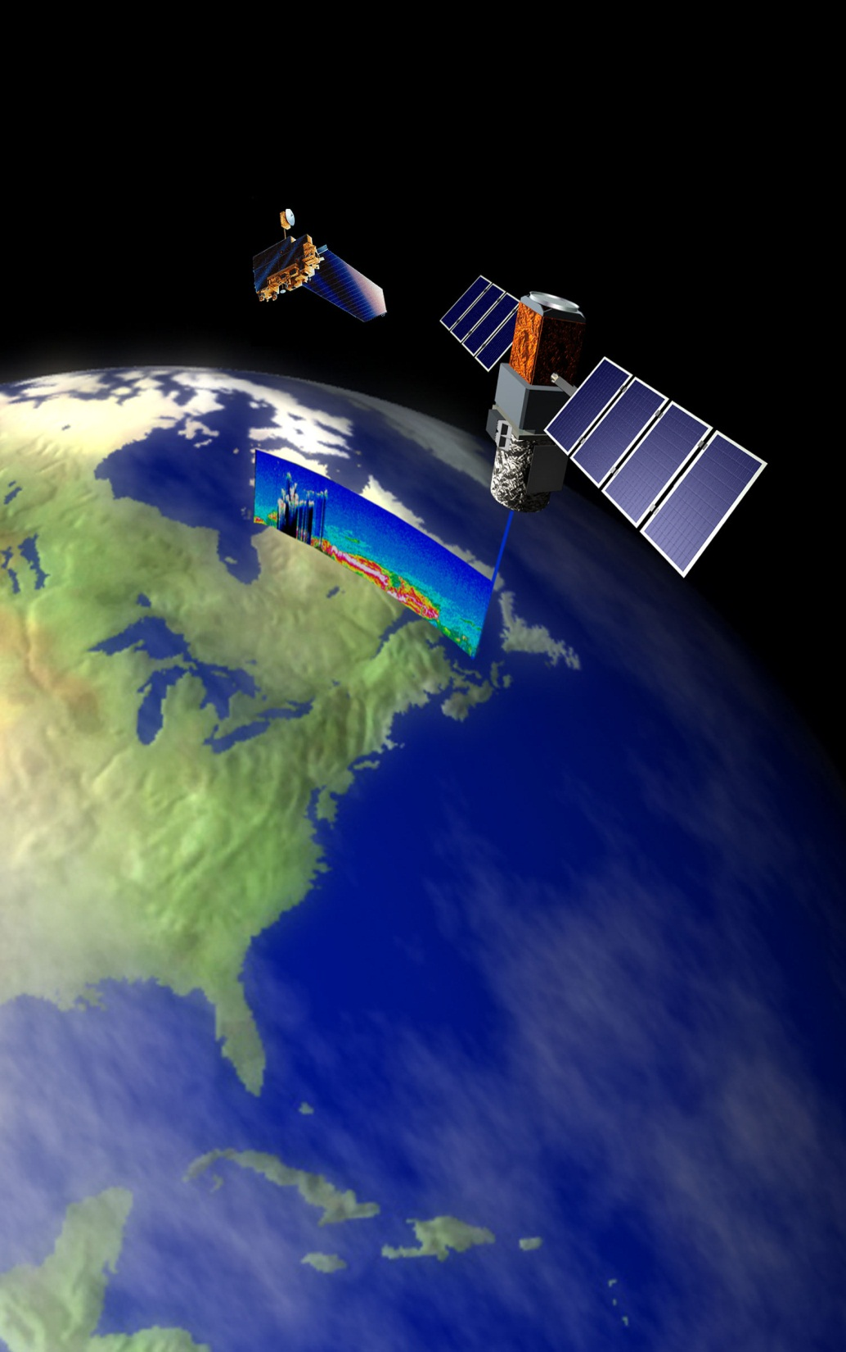
History of Meteorology
1960s:
TIROS I - the first weather satellite was launched.
Computers & satellites combined make meteorology very technical & a rapidly developing science.

Slide 34
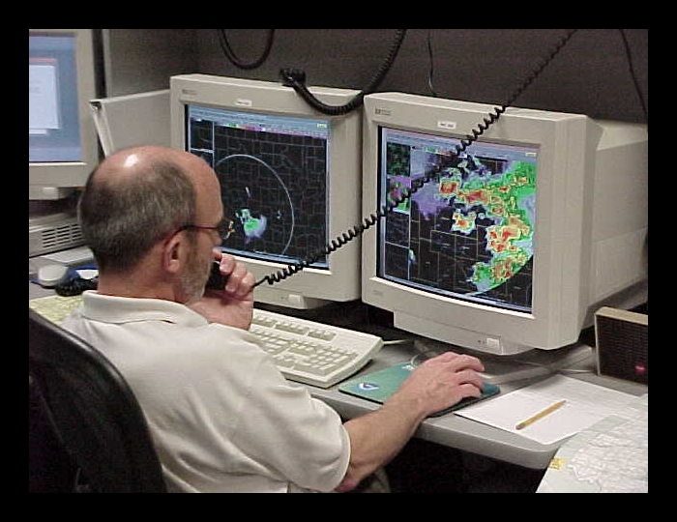
Modern Meteorological Computer!

